Slide 1

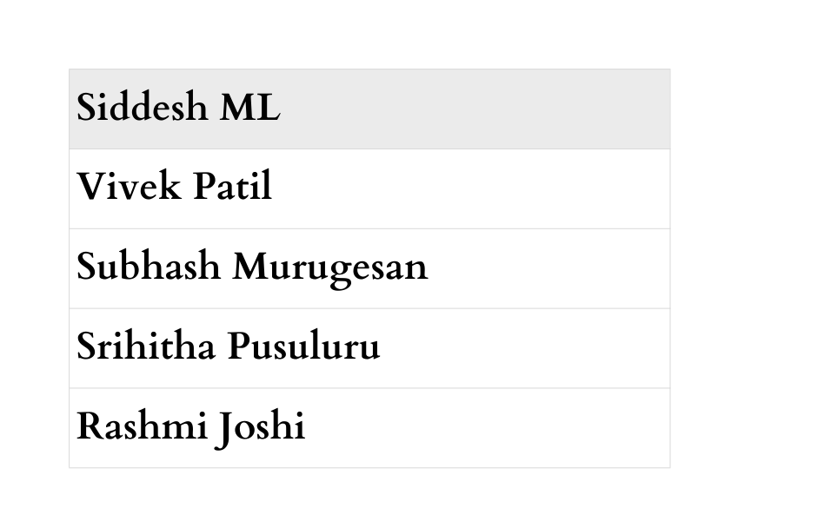
Project Review-A7
September 18, 2025

Slide 2

Agenda
Introduction (Problem Statement, Objectives)
Manual Test Cases ( UI, Functional and Defect)
Challenges in Manual Testing
Framework
Automated Test Cases and Reports
Jenkins Integration
Challenges in Automation Testing
Conclusion

Slide 3
Introduction
Problem Statement: Hybrid Testing Strategy for E-Commerce Web Application: Manual and Selenium-based Automation Testing Using Java : https://automationexercise.com/
Purpose: The goal of this capstone project is to demonstrates how a hybrid QA strategy improves overall test coverage and efficiency by leveraging both manual and automated approaches. It also validates the importance of frameworks, test reusability, and reporting in real-world QA.
Objectives:
Validate critical functionalities of the e-commerce site (login, search, cart, checkout, payment).
Ensure test coverage through both manual and automated test approaches.
Implement a maintainable Selenium automation framework using the Page Object Model (POM).
Log, track, and report defects using a defect log and test reports.
Compare manual vs automated testing effort, coverage, and efficiency.

Slide 4
Challenges in Manual Testing
Takes a Lot of Time:
Manually repeating tests This becomes especially time-consuming when testing multiple scenarios after every update.
Human Mistakes:
Testers may accidentally skip steps or enter incorrect data. This can lead to inaccurate results and missed bugs.
Hard to Keep Track:
As more features are added, updating a growing number of test cases becomes difficult. This can result in overlooked or incomplete tests.

Slide 5
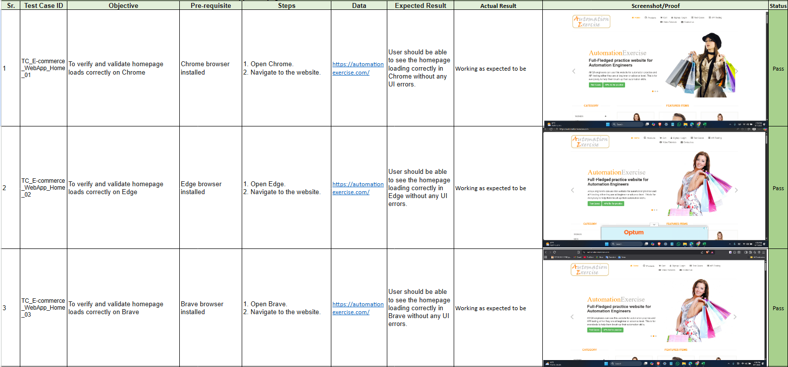
Manual Testcases (WebApp UI)
FILE LINK

Slide 6
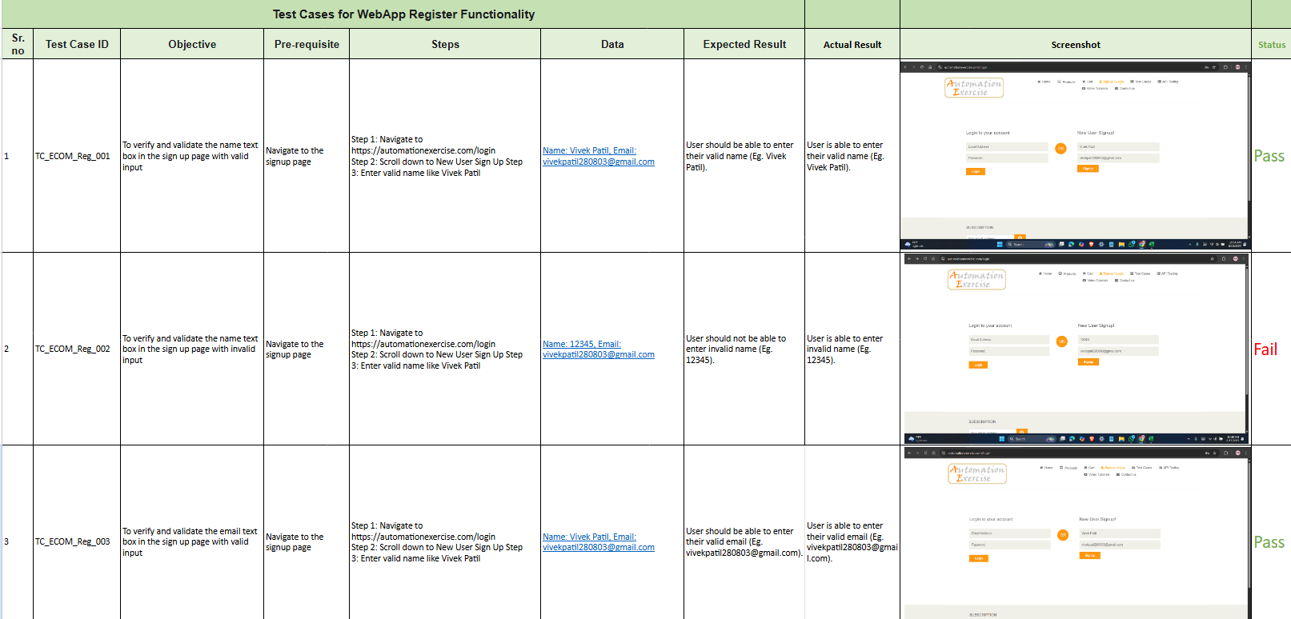
Manual Testcases (Functional)
FILE LINK

Slide 7
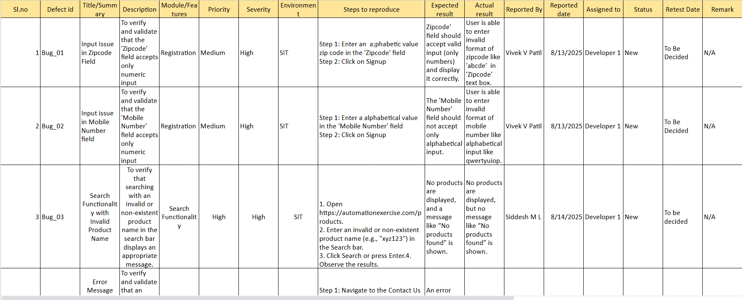
Manual Testcases (Defect Report)
FILE LINK

Slide 8
MANUAL TEST CASES OF ECOMMERCE WEB APPLICATION
UI Test Cases:
Verified layout consistency, responsiveness, and visual integrity.
Functional Test Cases :
Validated key workflows such as login, cart, and checkout.
Defect Report:
Documented identified issues with steps to reproduce, severity, and status for resolution tracking.
LINK FOR TEST CASE DOCUMENT :
https://drive.google.com/drive/folders/1u35suhUO2ZEM5WxIdCLMitI9Jh8x0Ete?usp=drive_link

Slide 9
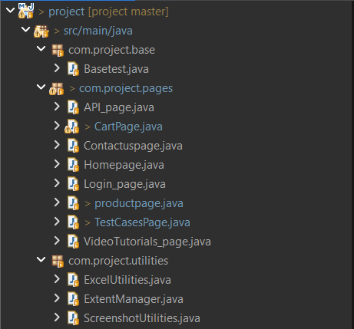
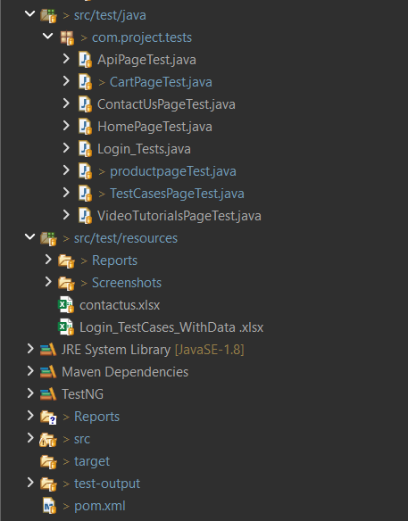
Framework
1. Page Object Model (POM)
Separates UI logic (Pages) from test validation (Tests).
Enhances code reusability and maintainability.
2. Data-Driven Testing
Test data is managed externally in Excel files.
Allows a single script to run multiple test variations efficiently.
3. Centralized Components
A Base test class controls the core test lifecycle (setup/teardown).
A Utilities package provides shared functions for reporting, screenshots, etc.
4. Modular Architecture
Each package has a clear and single responsibility.
Ensures the framework is organized, scalable, and easy to navigate.

Slide 10
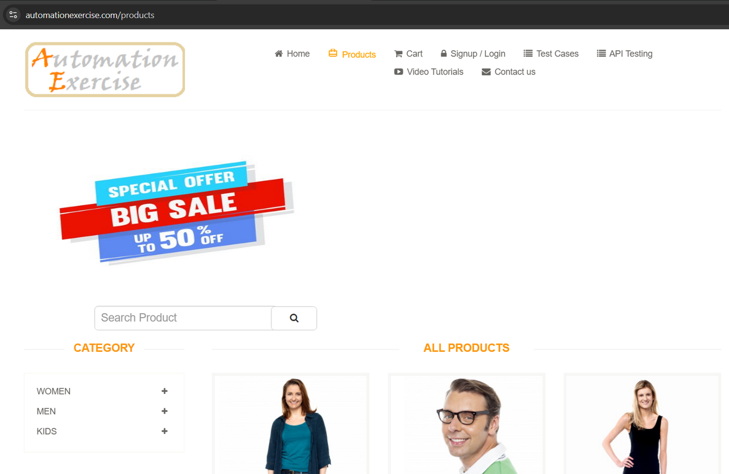
Test Cases - Product Page
Verify Products Displayed
Verify Valid Product Search
Verify Invalid Product Search
Verify Add to Cart
Verify Continue Shopping Button
Verify View Cart Button
Verify View First Product
Verify Different Categories (Men, Women, and Kids)
Verify Different Brands (Polo, H&M, Madame, Mast & Harbour, Babyhug, Allen Solly Junior, Kookie Kids, Biba)

Slide 11
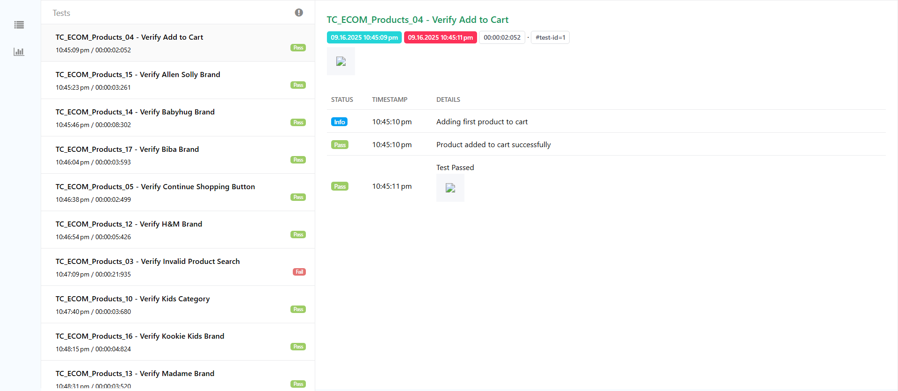
Generated Report

Slide 12
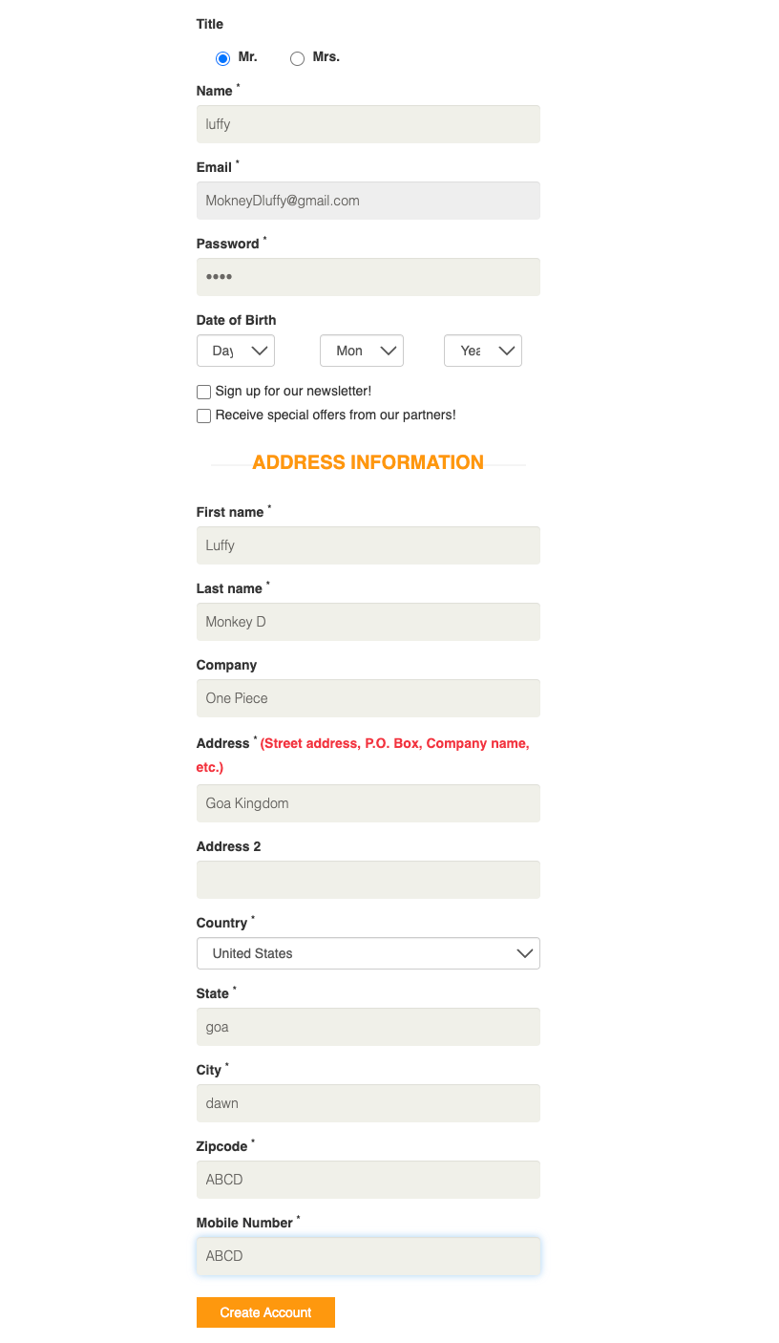
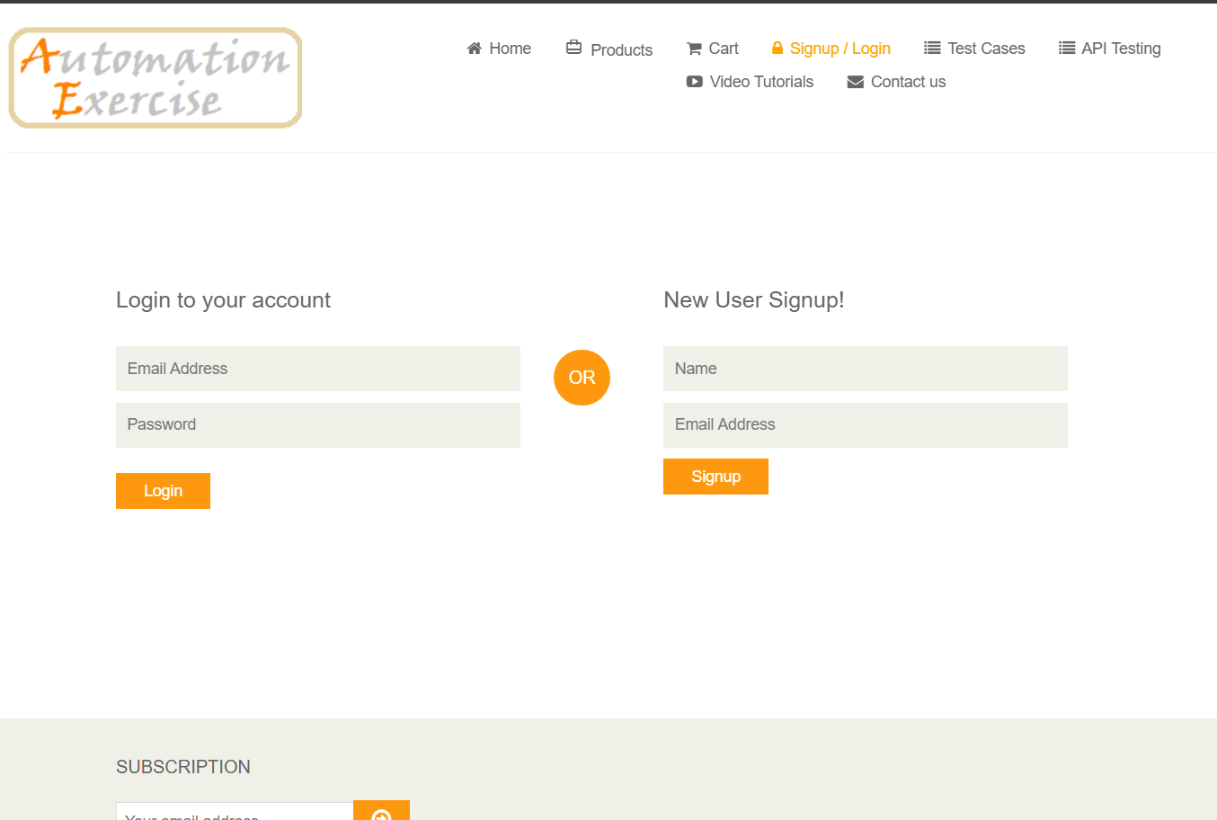
Test Cases - Signup Page

Slide 13
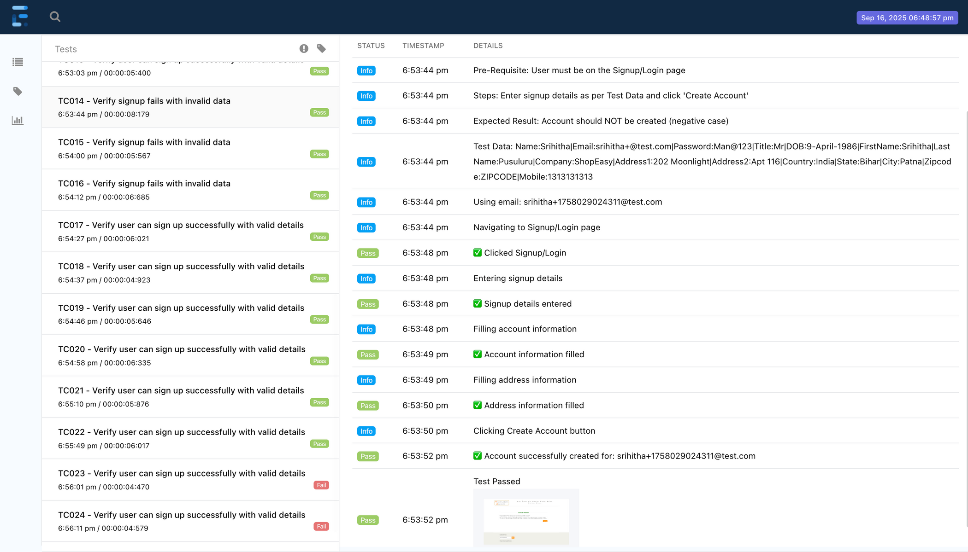
Generated Report

Slide 14
Test Cases - Login Page
Test Login functionality as a User (with data from Excel)

Slide 15
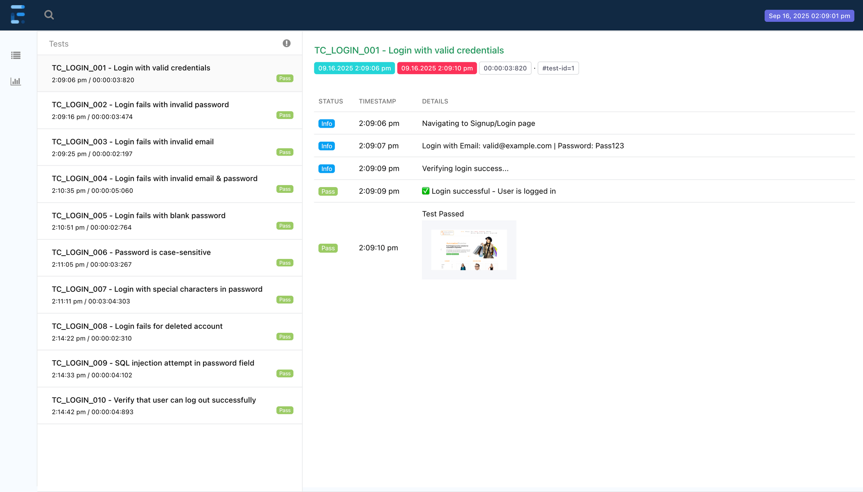
Generated Report

Slide 16

PROJECT REPOSITORY ON GITHUB
All automation scripts and resources uploaded to GitHub
Centralized repository for team collaboration
Maintains version control and change history
Easy access for trainers/reviewers via shared link
Ensures project transparency and reusability
LINK FOR GIT REPOSITORY
Get Link

Slide 17
Jenkins Integration
What is Jenkins:
Jenkins is an open-source automation server that helps automate parts of the software development process especially building, testing, and deploying applications.
Steps to integrate:
Activate Jenkins using system terminal “brew services start jenkins-lts”
Open & login: http://localhost:8080/
New Item → Give Project name → Freestyle Project
Source Code Management (SCM) → Git → Repo URL: https://github.com/sidsiddesh11/project.git
Build Steps → Execute Windows batch command → Command → MVN Clean Test
Save & Run Build

Slide 18
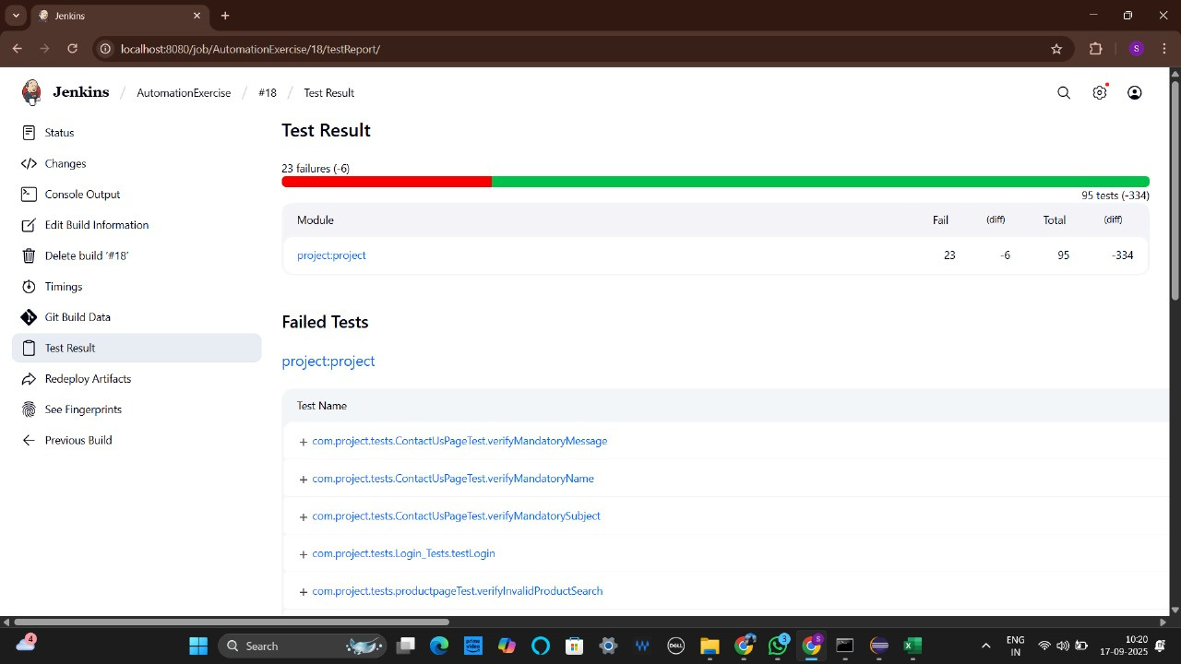
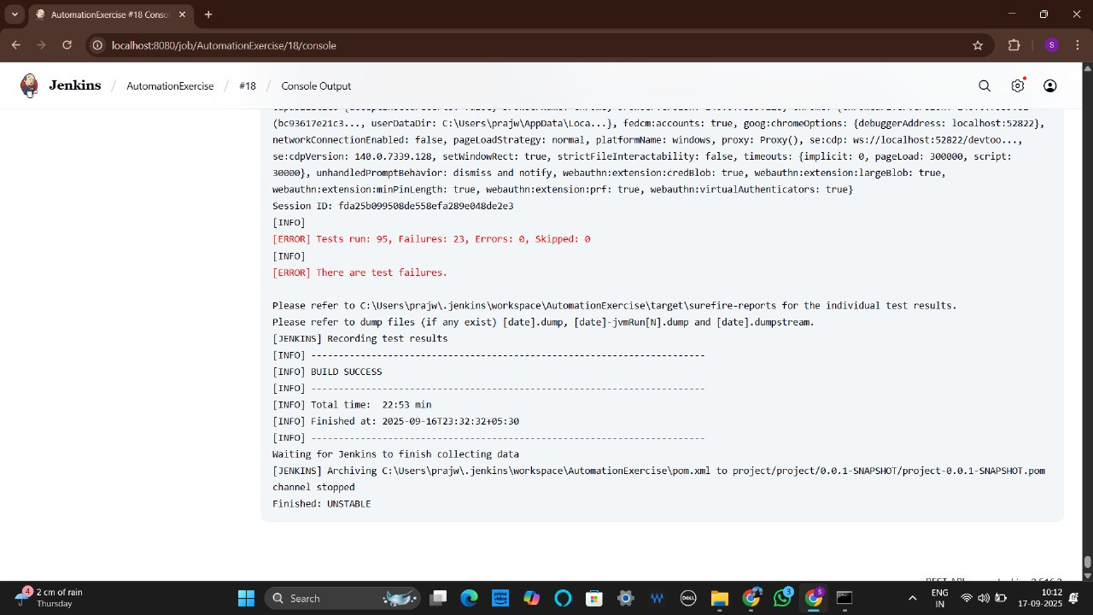
Jenkins Integration

Slide 19

Challenges in Automation Testing
Dynamic Elements:
Changing IDs/locators break scripts
Synchronization Issues:
Handling page load and wait times
Cross-Browser Compatibility:
Ensuring consistent behavior across browsers
Environment Stability:
Failures caused by unstable servers or network
Maintenance of Automation Scripts:
Frequent updates after UI/code changes
Integration:
Challenges with CI/CD and third-party tool integration

Slide 20
Conclusion
Implemented a Hybrid QA Strategy combining Manual Testing and Selenium + TestNG Automation for an E-Commerce Web Application.
Achieved comprehensive test coverage of critical workflows (Login, Search, Cart, Checkout, Payment) with higher accuracy and faster execution.
Page Object Model (POM) and Data-Driven Testing ensured maintainability, scalability, and reusability of the automation framework.
Manual testing provided valuable exploratory insights and UI/UX validation, while automation accelerated regression testing and defect detection.
Generated detailed reports and defect logs that improved transparency and decision-making.

Slide 21
Thank you!

